Slide 1



Data Structure
&
Algorithm
Class VIII
lab 14

Slide 2

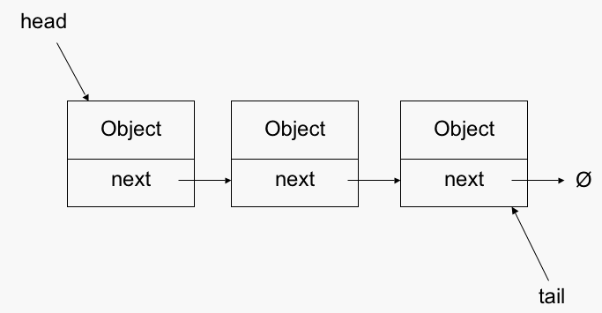
Linked List
A linked list is a sequence of data structures, which are connected together via links

Slide 3
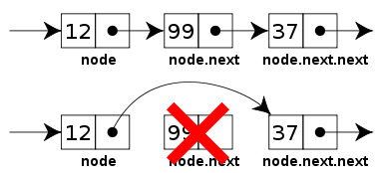
sequence of Linked List
Link
Next
LinkedList

Slide 4
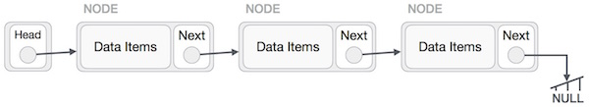
Linked List Representation
Linked list can be visualized as a chain of nodes, where every node points to the next node

Slide 5
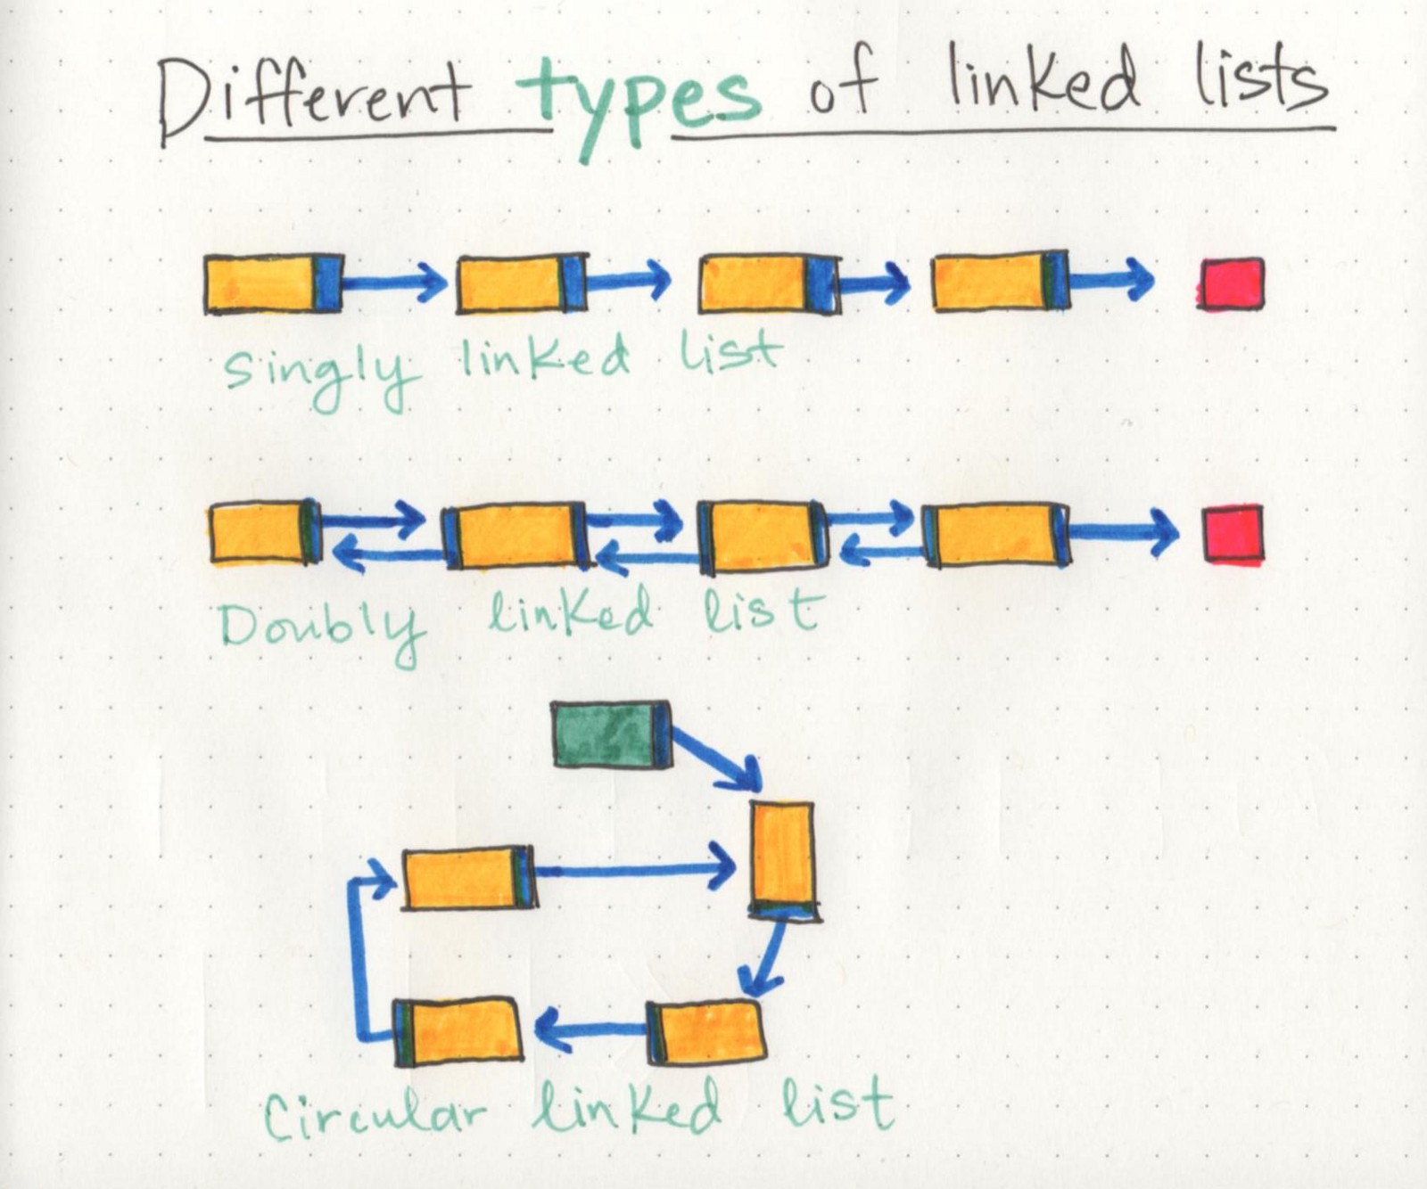
Types of Linked List
Different Types of linked list
Simple Linked List
Doubly Linked List
Circular Linked List
Simple
Double
circular

Slide 6
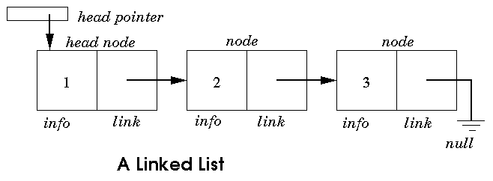
Simple Linked List
Item navigation is forward only

Slide 7
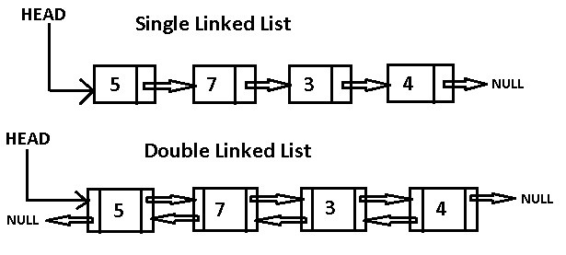
Doubly Linked List
Items can be navigated forward and backward

Slide 8
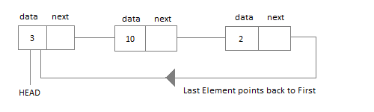
Circular Linked List
Last item contains link of the first element as next and the first element has a link to the last element as previous

Slide 9
Circular Linked List
Last item contains link of the first element as next and the first element has a link to the last element as previous

Slide 10
Basic Operations
Insertion
Deletion
Display
Search
Delete

Slide 11


